Slide 1


Slide 2
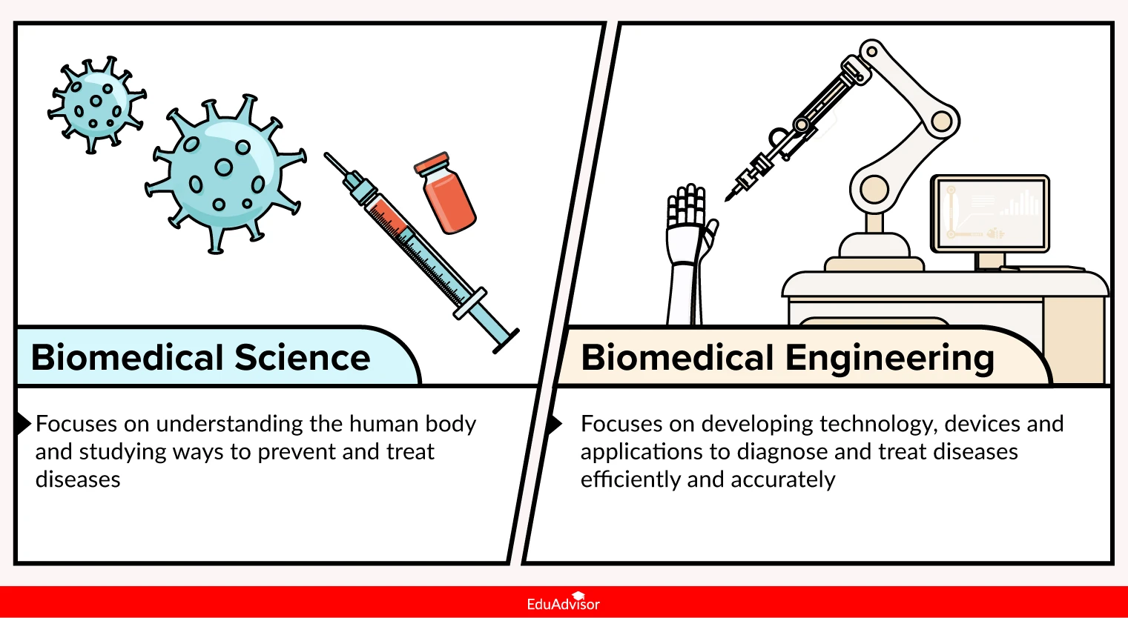
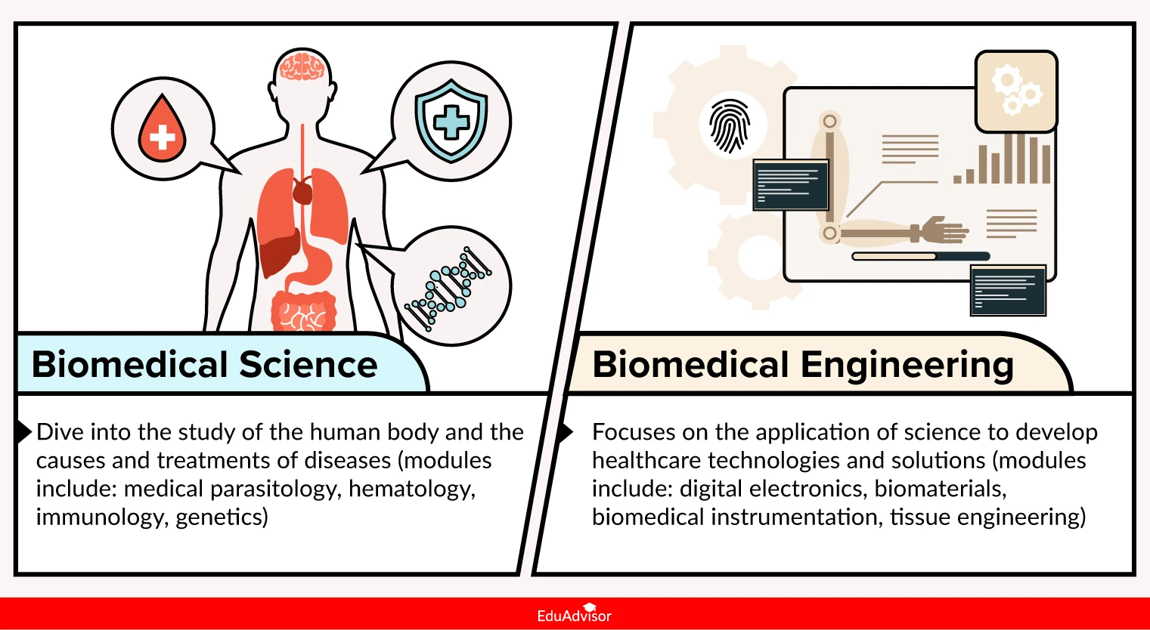
The application of engineering principles and design concepts to medicine and biology for healthcare purposes, such as diagnosis, monitoring, and therapy

Slide 3
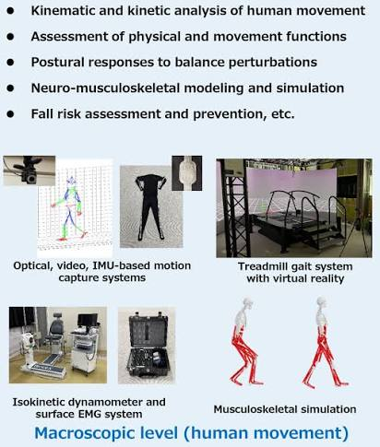
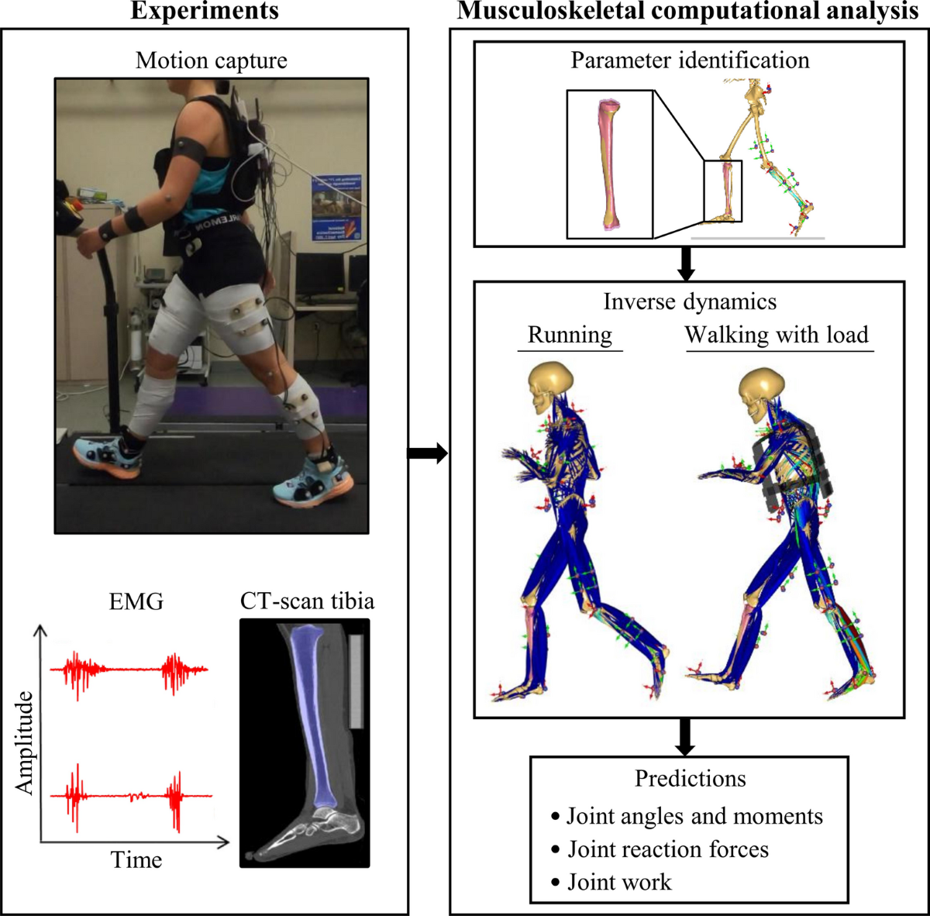
Biomechanics: Applies classical mechanics and forces to biological systems, human movement, and orthopedic devices.

Slide 4
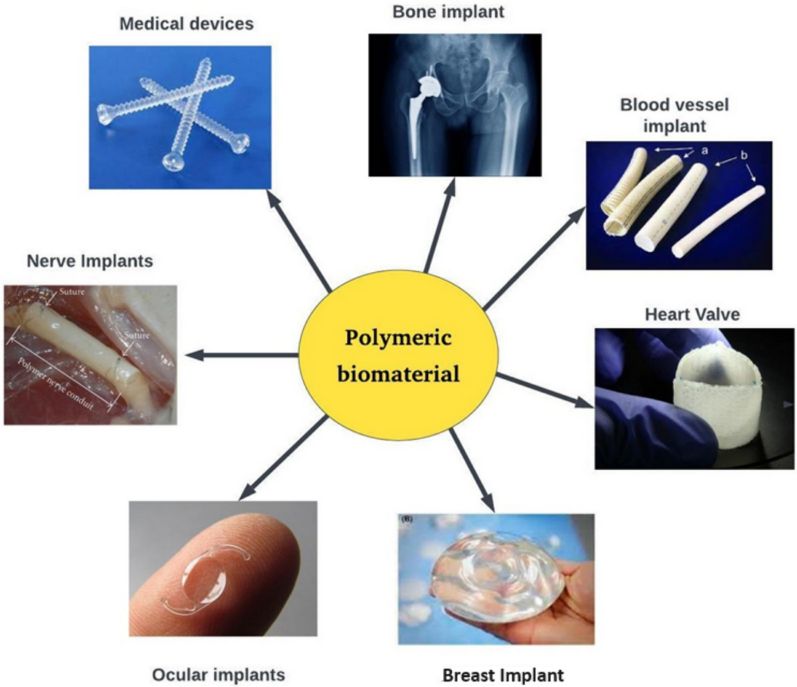
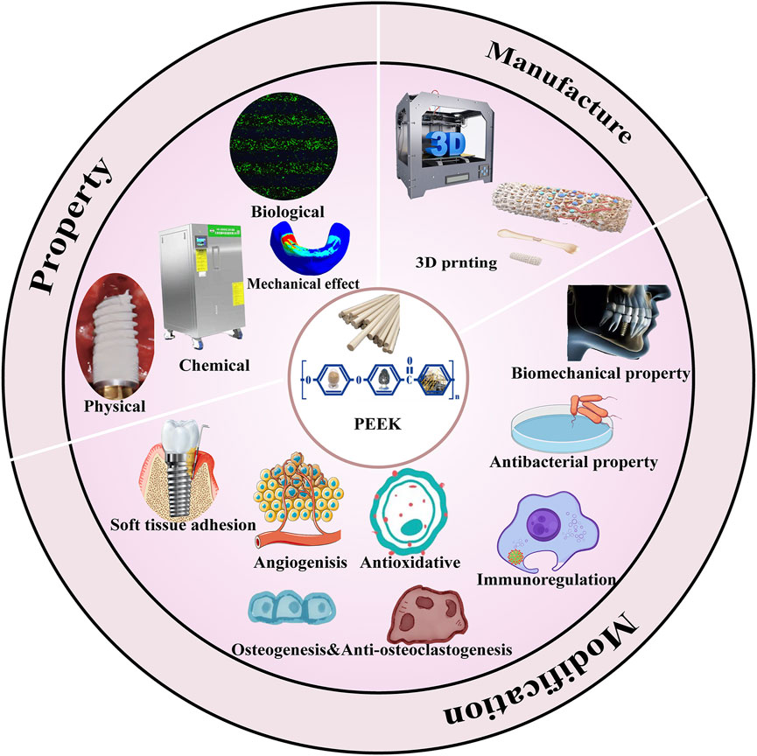
Biomaterials: Focuses on natural or synthetic materials—like polymers, metals, and ceramics—that are compatible with living tissue for implants and prosthetics.

Slide 5
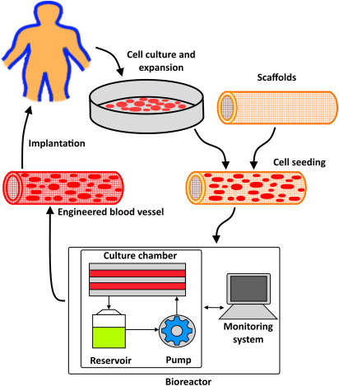
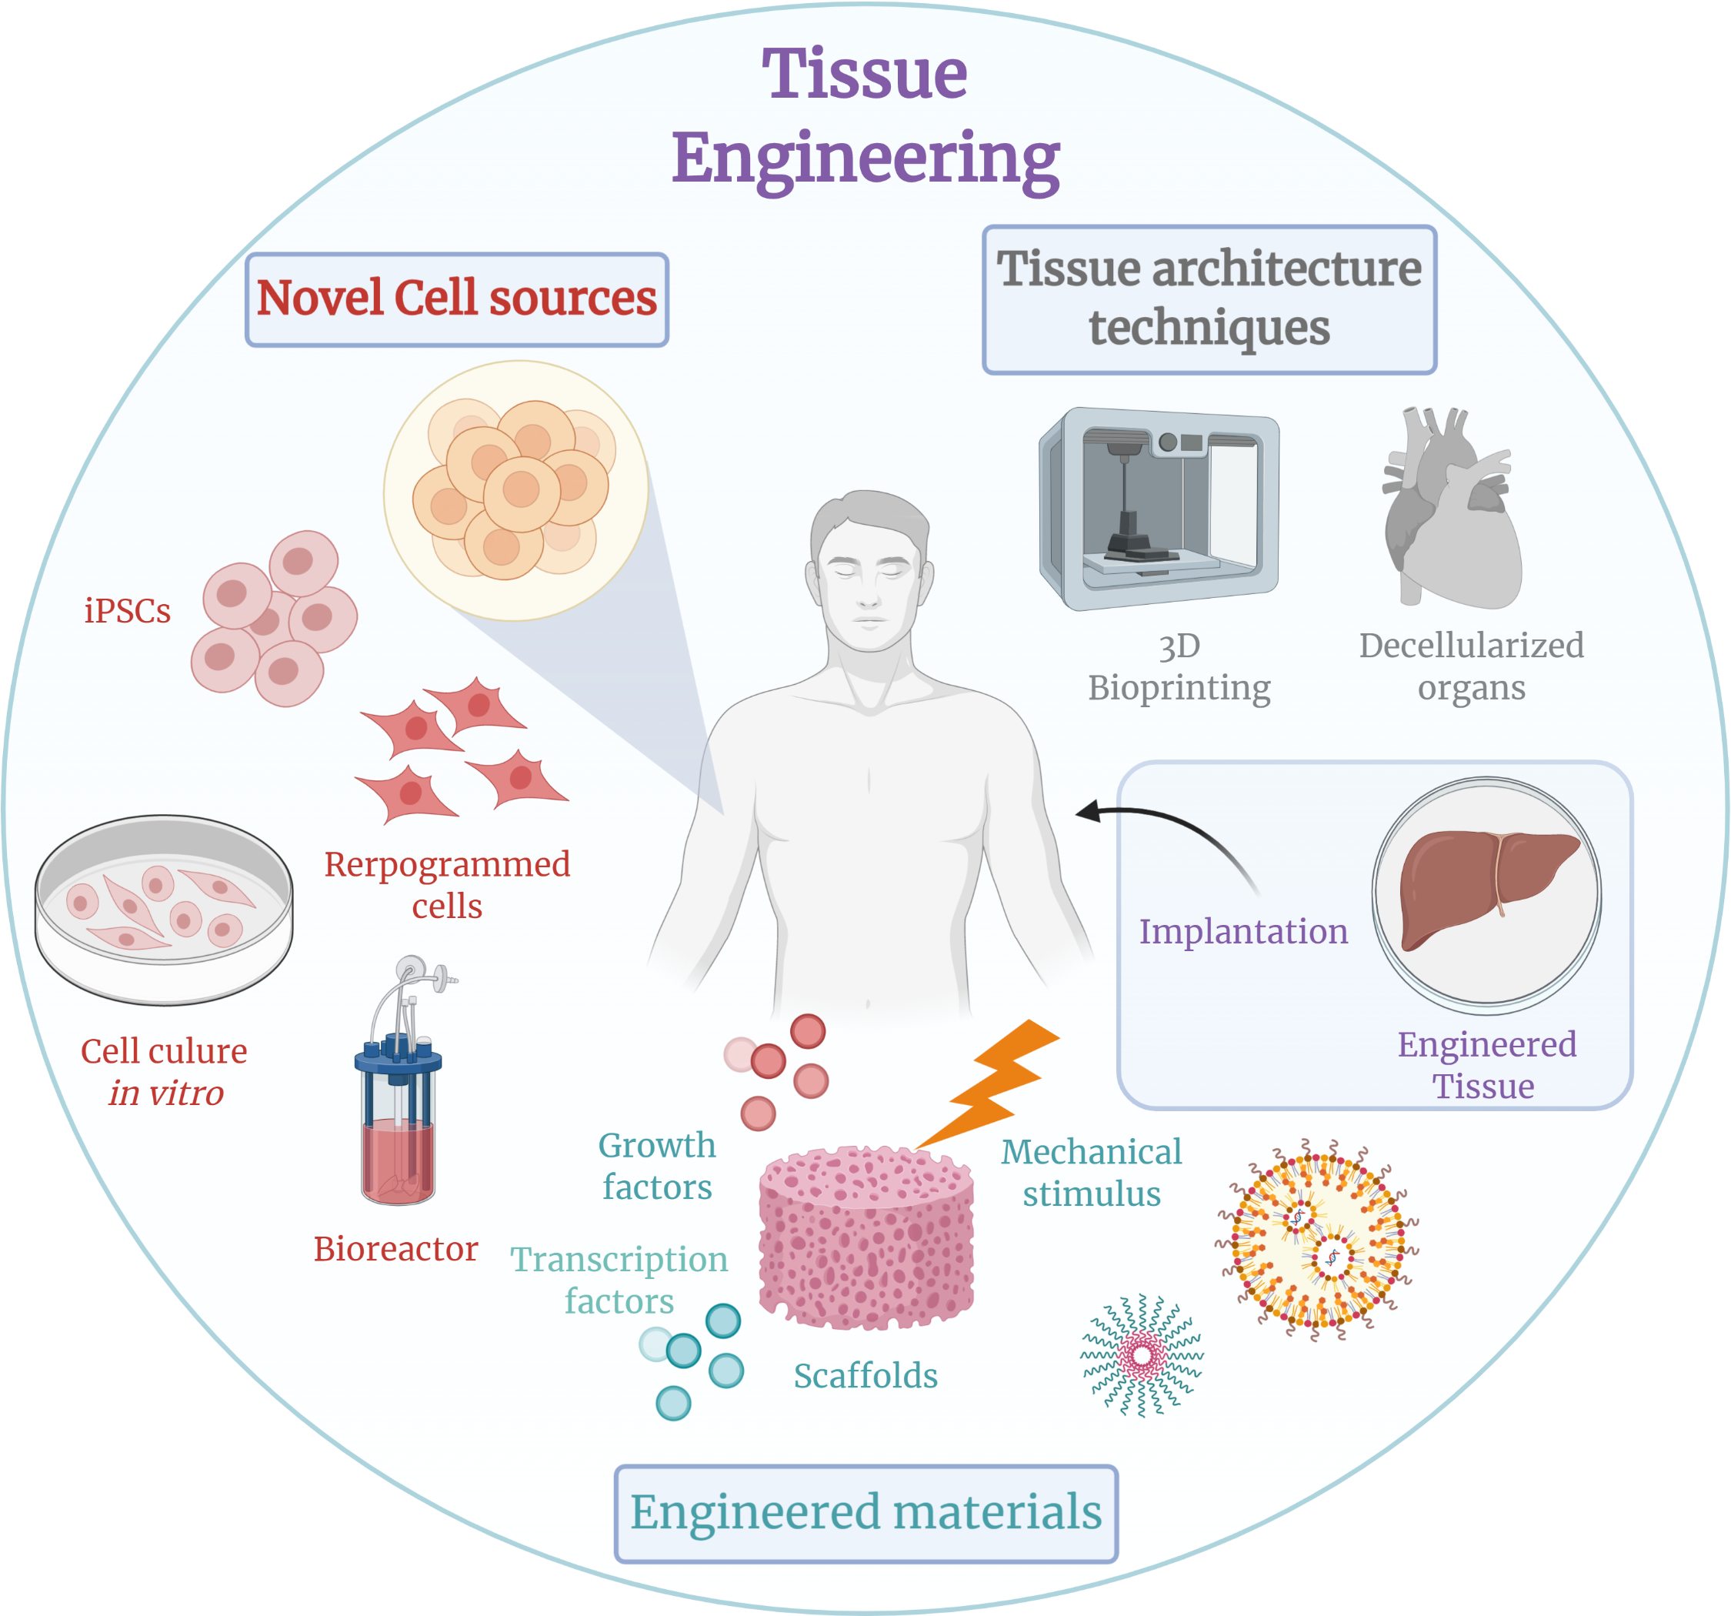
Tissue Engineering: Works on creating artificial organs, regenerative medicine, and biological substitutes using cell cultures and scaffolds.

Slide 6
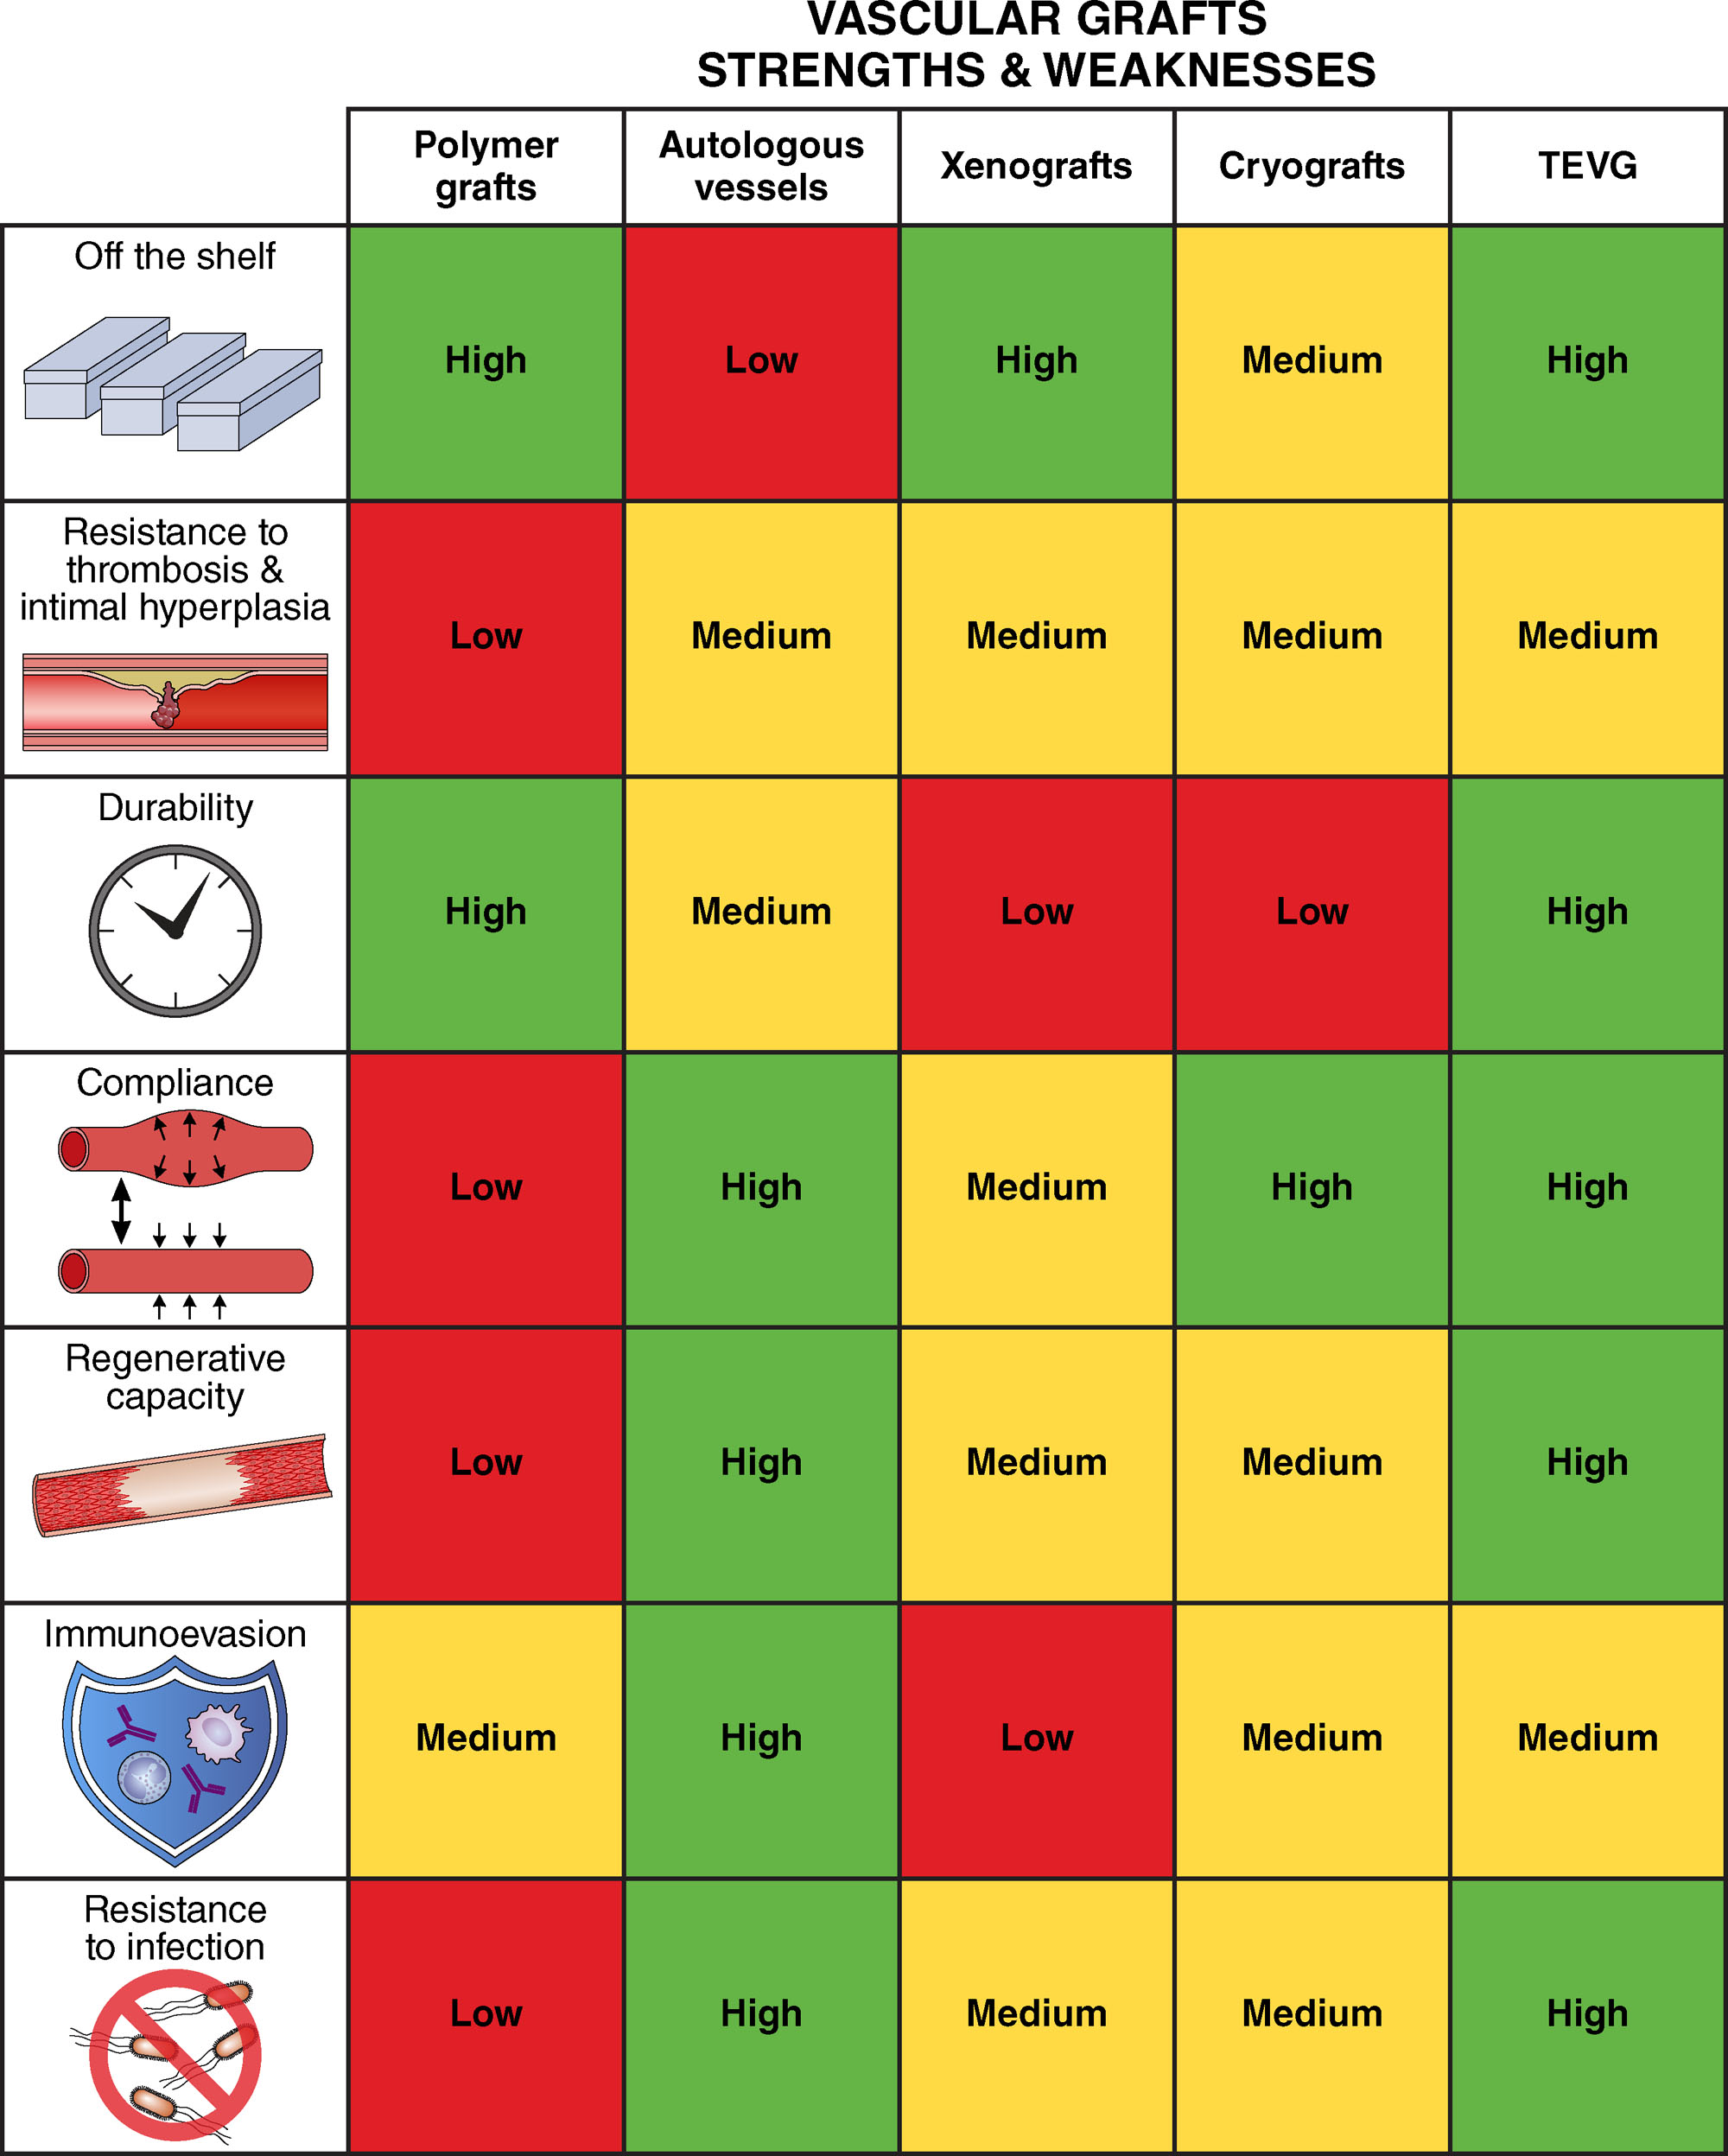
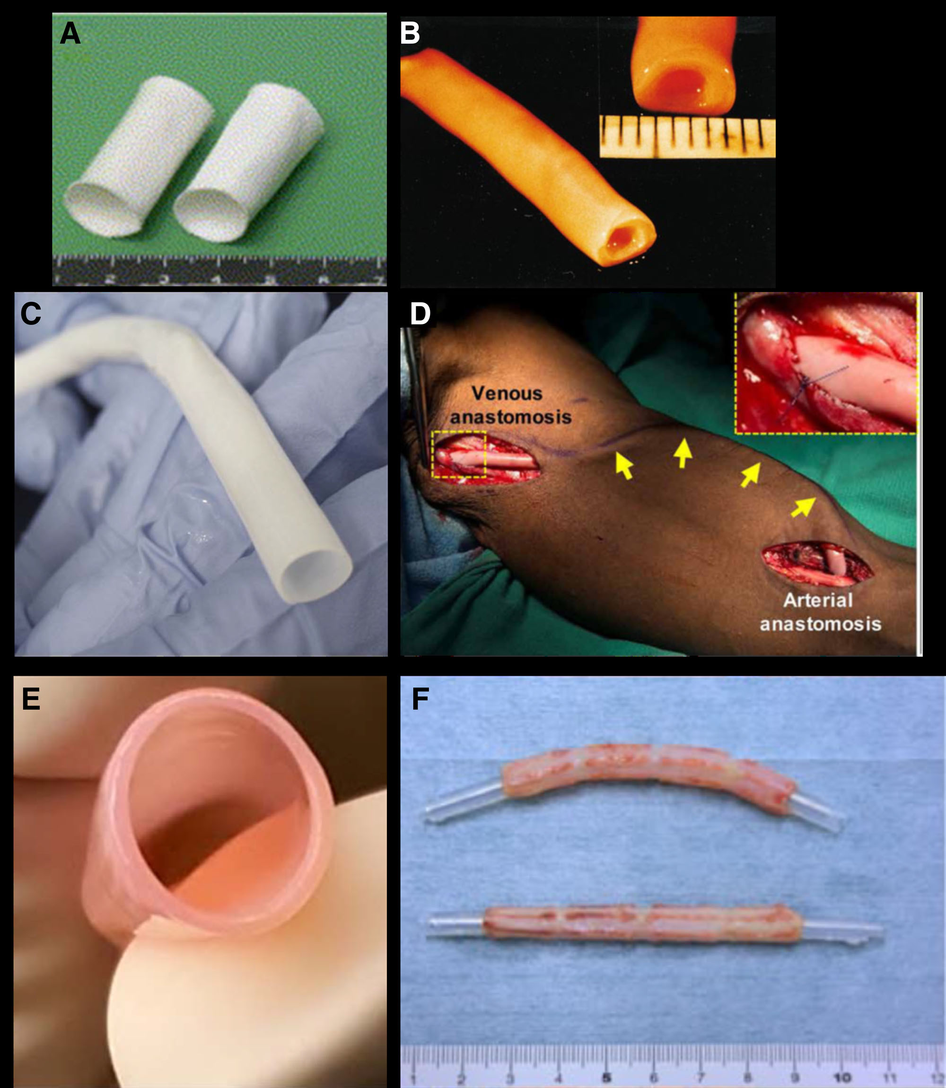

Slide 7
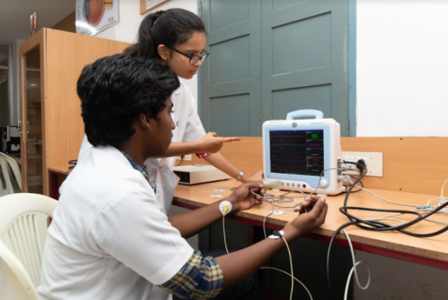
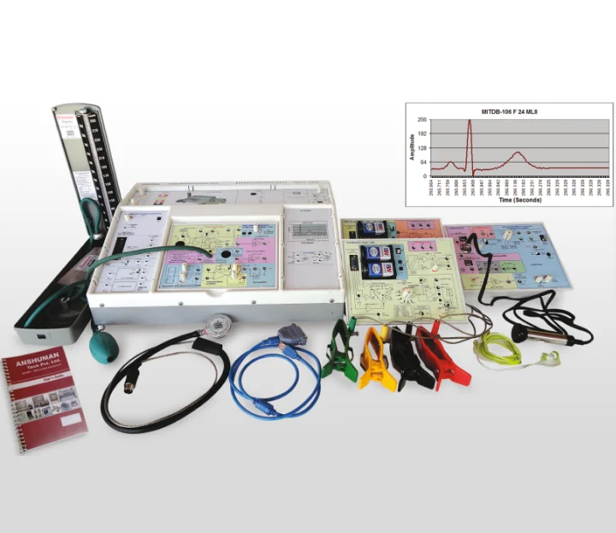
Bioinstrumentation: Utilizes electronics, sensors, and computer measurements to design diagnostic and therapeutic tools like ECGs and ventilators

Slide 8
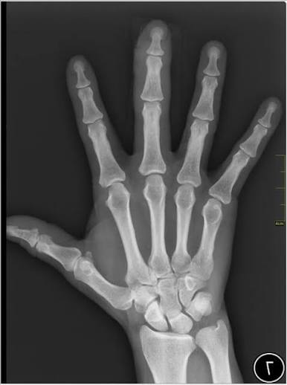
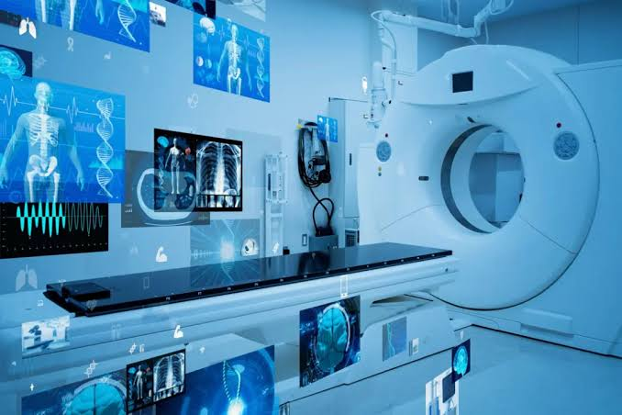
Medical Imaging: Develops non-invasive visualization technologies including MRI, CT scans, X-rays, and ultrasound systems.

Slide 9
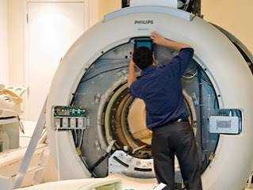
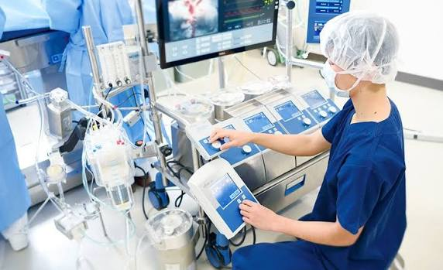
Clinical Engineering: Manages medical equipment procurement, routine calibration, safety audits, and maintenance inside hospitals

Slide 10
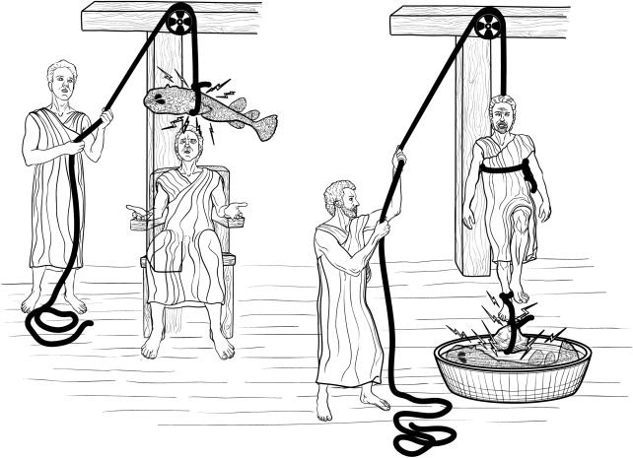

Slide 11
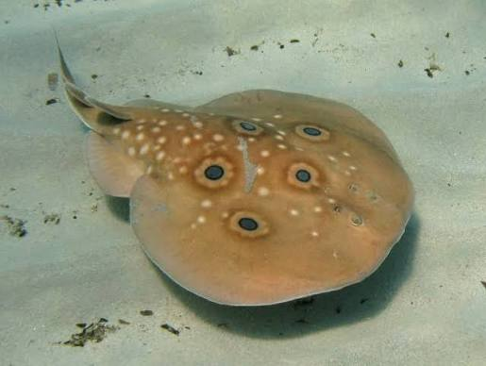
Shock treatment for chronic headache and gout

Slide 12
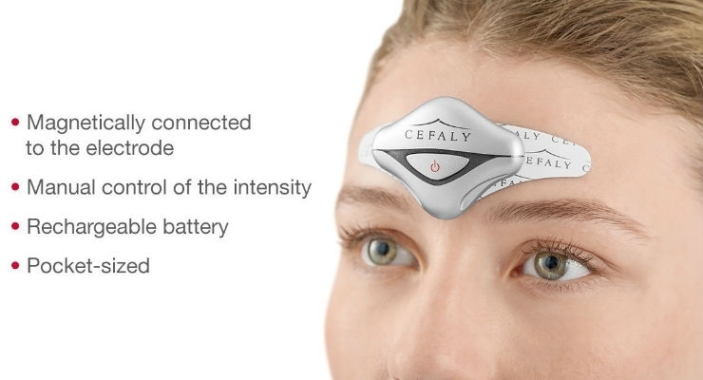

Slide 13
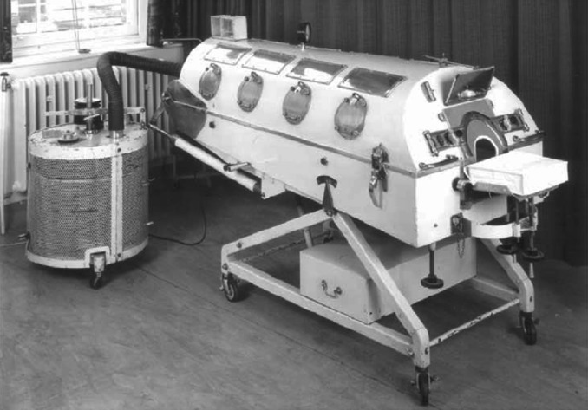
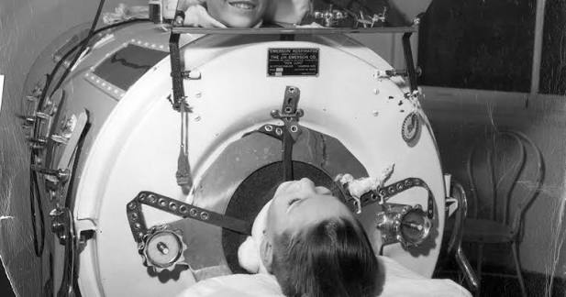
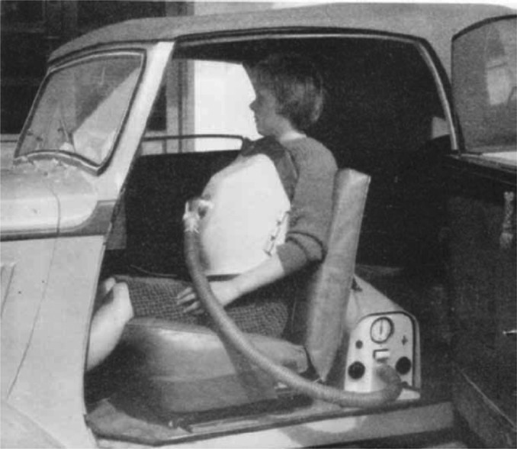
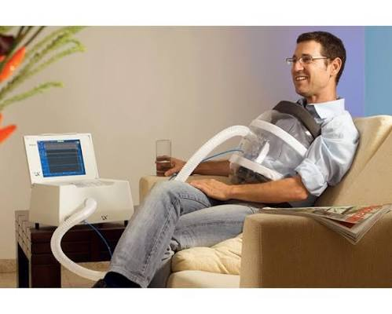
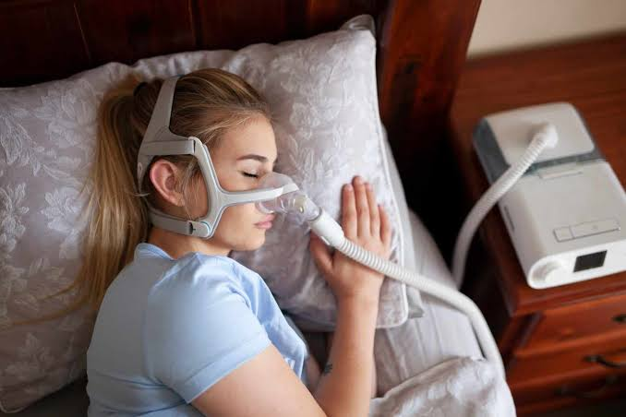

Slide 14
Feature | The Iron Lung (Past) | Modern Mechanical Ventilator (Present)
Pressure Type | Negative pressure (vacuum forces chest to expand) | Positive pressure (pushes air directly into lungs)
Patient Mobility | Completely trapped inside a steel tank | Portable; patients can sit up, be moved, or use wheelchairs
Medical Access | Hard for doctors to access the patient's body | Full body access for nursing care and physical therapy
Versatility | Only effective for paralyzed muscles (failed with pneumonia) | treat complex lung conditions, fluid buildup, and infections
Can

Slide 15
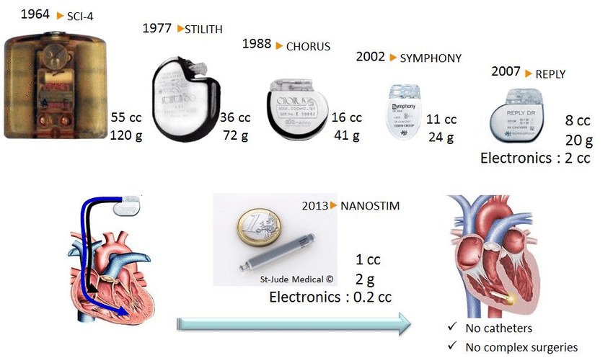
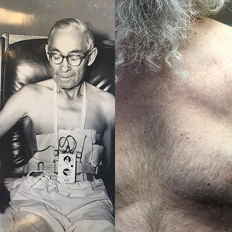
Pacemaker

Slide 16
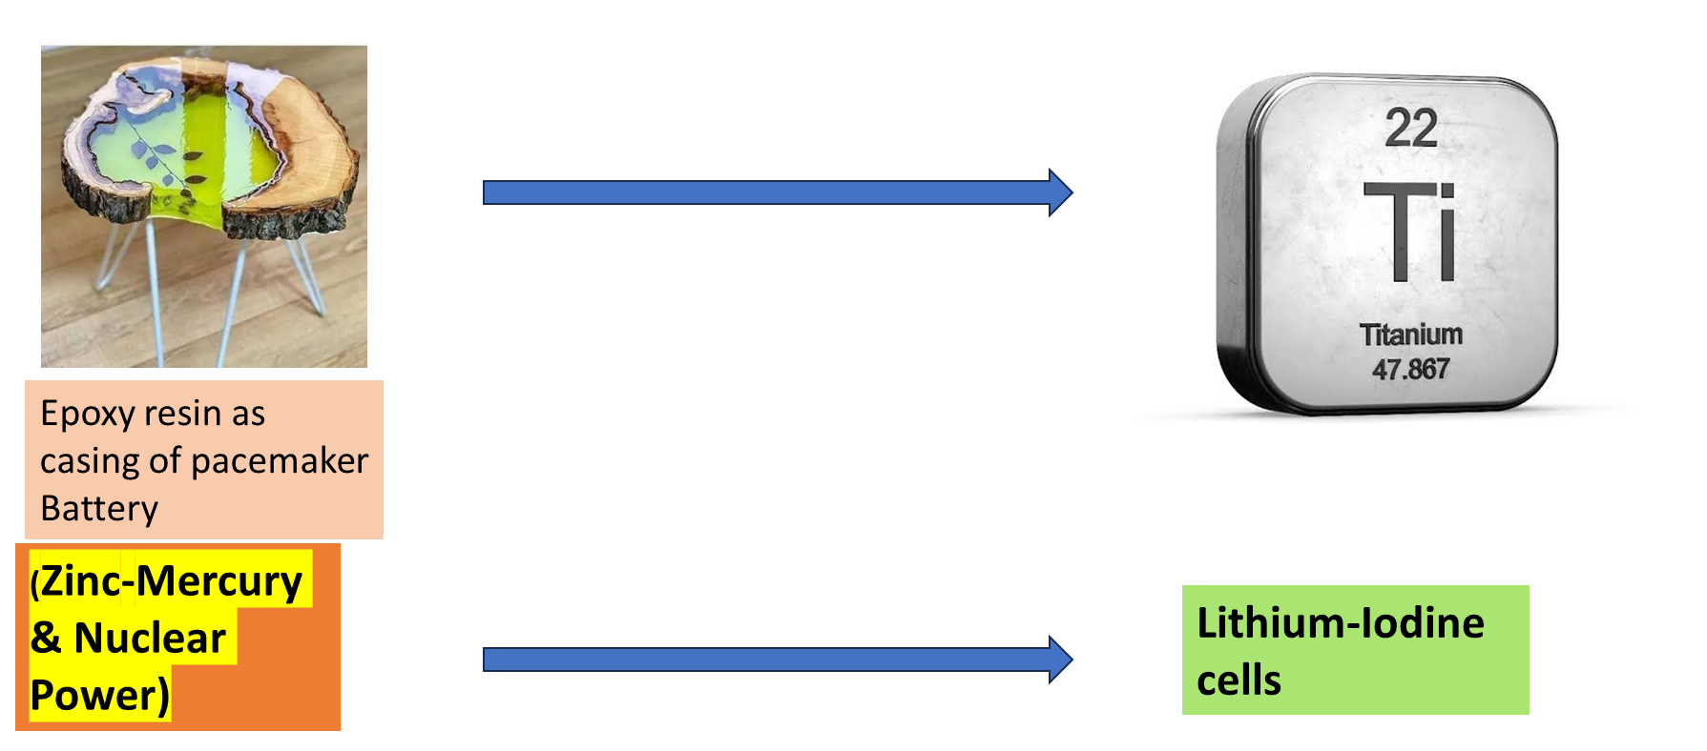

Slide 17
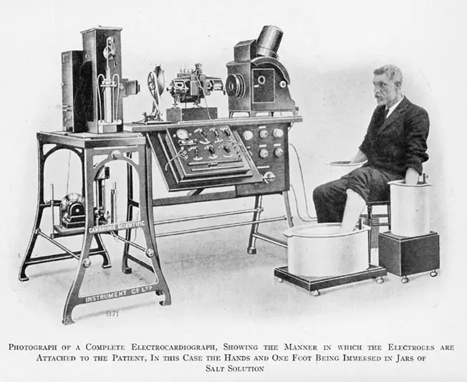
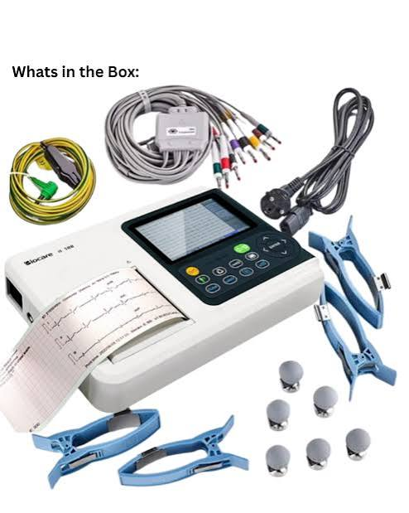
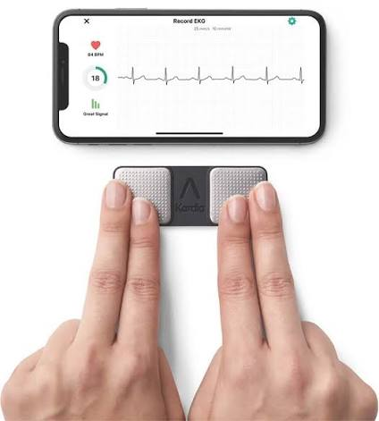
ECG

Slide 18
Feature | The Past (Early 20th Century) | The Present
Size & Portability | Weighed over 270 kg (600 lbs); required a massive room. | Weighs less than a few ounces; fits in a pocket or on a wrist
The Patient Experience | Hands and feet were dunked directly into buckets of saltwater. | Small, peel-and-stick disposable adhesive gel electrodes
Safety | High risk of electric shock; required huge electromagnets. | Completely safe, battery-operated, micro-insulated systems
Data Output | Traced by a bulb projection onto a photographic plate or rolling graph paper. | Instantaneous digital wave rendering on high-res monitors and PDFs
Interpretation | Manual calculation by a specialized cardiologist using a physical ruler | AI-driven instant diagnostics flagging rhythm anomalies in real-time.

Slide 19
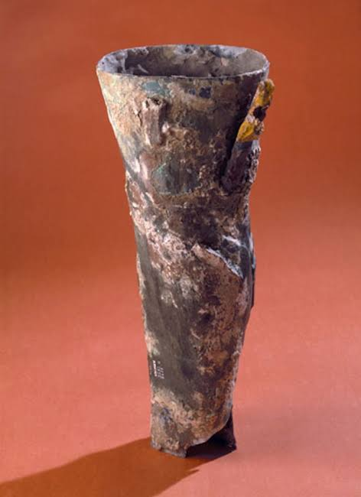
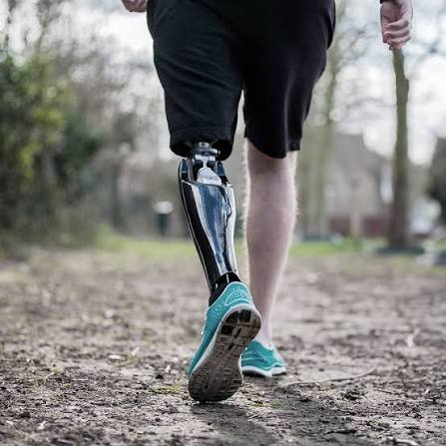

Slide 20
Feature | Ancient Prosthetics | Current Prosthetics
Primary Materials | Bronze, iron, copper, and solid wood strapped with leather. | Carbon fiber composites, titanium, and silicone
Functionality | Extremely stiff; designed primarily to hide a missing limb or stand still. | Dynamic energy return; lets users run, swim, and climb stairs
Control Mechanism | None; completely passive peg or dead weight | Microprocessors and sensors adjust joint resistance 50 times a second
Attachment | Crude leather belts and heavy straps cutting into the skin | Custom-molded sockets with vacuum suspension and silicone liners

Slide 21
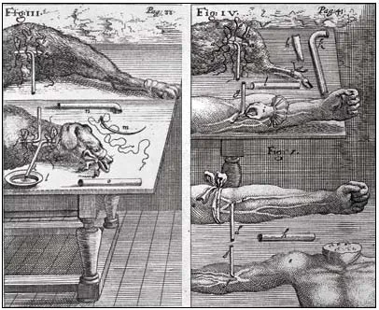
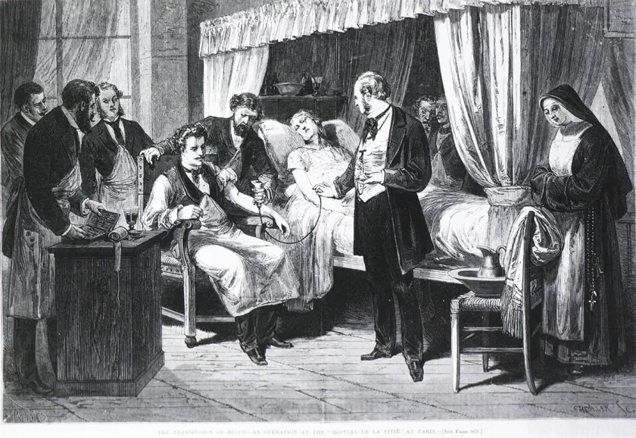

Slide 22
Technology/device | Problem addressed | Why it became successful
Pacemaker | Abnormal/slow heart rhythm | Reliable electrical stimulation of the heart; miniaturization and improved battery technology
Artificial hip replacement | Severe joint damage/arthritis | Improved biomaterials, biomechanics and implant design
Insulin pump | Continuous insulin delivery | Controlled drug delivery and improved electronic/sensor technology
Pulse oximeter | Monitoring blood oxygen | Non-invasive measurement, simple operation and rapid clinical feedback
Cochlear implant | Severe hearing loss | Converts sound into electrical signals that stimulate the auditory nerve
Modern prosthetic limbs | Loss of limb function | Combination of biomechanics, materials, electronics and increasingly sensors
Mechanical ventilator | Respiratory failure | Controlled delivery of oxygen/air and adjustable pressure/volume

Slide 23
Technology/device | What happened | Main lesson
Dalkon Shield IUD | Introduced in the 1970s; associated with serious infections and other complications | Device safety and clinical testing are essential
Bjork–Shiley heart valve | Certain valve models experienced structural failure, including fracture of the valve strut | Long-term mechanical fatigue testing matters
DePuy ASR hip implant | Metal-on-metal hip implants had higher-than-expected failure/revision problems | Material selection, wear and long-term biological effects matter
PIP breast implants | Industrial-grade silicone rather than approved medical-grade material was used in implants | Manufacturing quality and regulatory oversight are critical
Therac-25 | Radiation therapy machine involved software and human machine interaction problems that contributed to radiation overdoses | Software safety and human factors are biomedical-engineering issues
Artificial heart / early total artificial heart attempts | Early systems had problems such as infection, blood clotting, durability and power requirements | Biological compatibility and engineering reliability must be considered together
Metal-on-metal hip implants | Wear could release metal particles/ions into surrounding tissue | A mechanically strong material is not automatically biologically suitable

